Slide 1
Chapter 4 Mathematical Functions, Characters, and Strings

Slide 2
The String Type
The char type only represents one character. To represent a string of characters, use the data type called String. For example,
String message = "Welcome to Java";
String is actually a predefined class in the Java library just like the System class and Scanner class. The String type is not a primitive type. It is known as a reference type. Any Java class can be used as a reference type for a variable. Reference data types will be thoroughly discussed in Chapter 9, “Objects and Classes.” For the time being, you just need to know how to declare a String variable, how to assign a string to the variable, how to concatenate strings, and to perform simple operations for strings.

Slide 3
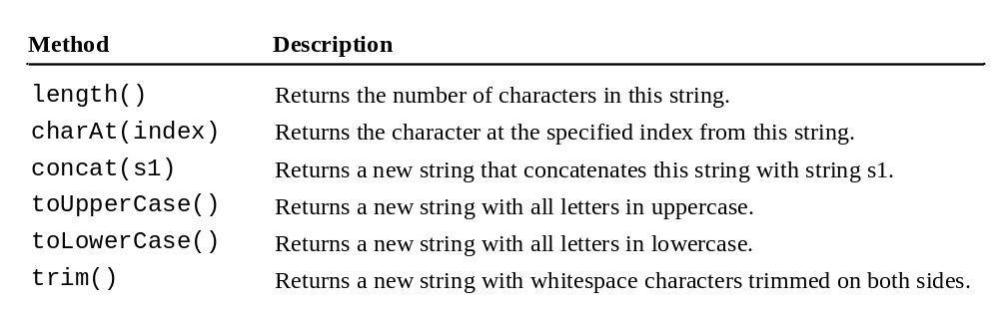
Simple Methods for String Objects

Slide 4
Simple Methods for String Objects
Strings are objects in Java. The methods in the preceding table can only be invoked from a specific string instance. For this reason, these methods are called instance methods. A non-instance method is called a static method. A static method can be invoked without using an object. All the methods defined in the Math class are static methods. They are not tied to a specific object instance. The syntax to invoke an instance method is
referenceVariable.methodName(arguments).

Slide 5
Getting String Length
String message = "Welcome to Java";
System.out.println("The length of " + message + " is "
+ message.length());

Slide 6
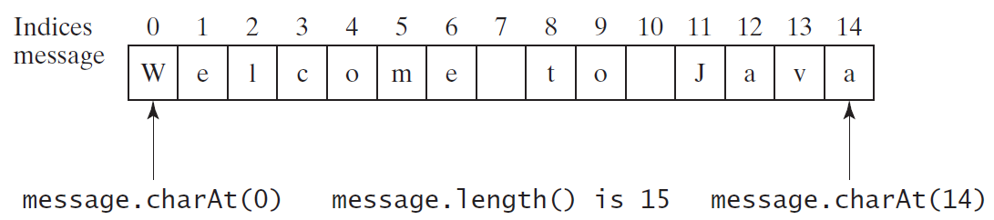
Getting Characters from a String
String message = "Welcome to Java";
System.out.println("The first character in message is "
+ message.charAt(0));

Slide 7
Converting Strings
"Welcome".toLowerCase() returns a new string, welcome.
"Welcome".toUpperCase() returns a new string, WELCOME.
" Welcome ".trim() returns a new string, Welcome.

Slide 8
String Concatenation
String s3 = s1.concat(s2); or String s3 = s1 + s2;
// Three strings are concatenated
String message = "Welcome " + "to " + "Java";
// String Chapter is concatenated with number 2
String s = "Chapter" + 2; // s becomes Chapter2
// String Supplement is concatenated with character B
String s1 = "Supplement" + 'B'; // s1 becomes SupplementB

Slide 9
Reading a String from the Console
Scanner input = new Scanner(System.in);
System.out.print("Enter three words separated by spaces: ");
String s1 = input.next();
String s2 = input.next();
String s3 = input.next();
System.out.println("s1 is " + s1);
System.out.println("s2 is " + s2);
System.out.println("s3 is " + s3);

Slide 10
Reading a Character from the Console
Scanner input = new Scanner(System.in);
System.out.print("Enter a character: ");
String s = input.nextLine();
char ch = s.charAt(0);
System.out.println("The character entered is " + ch);

Slide 11
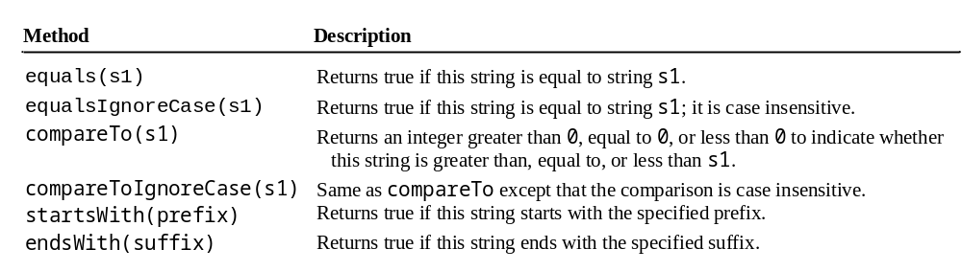
Comparing Strings
OrderTwoCities
Run

Slide 12
OrderTwoCities.java
Page 136 Listing 4.2

Slide 13
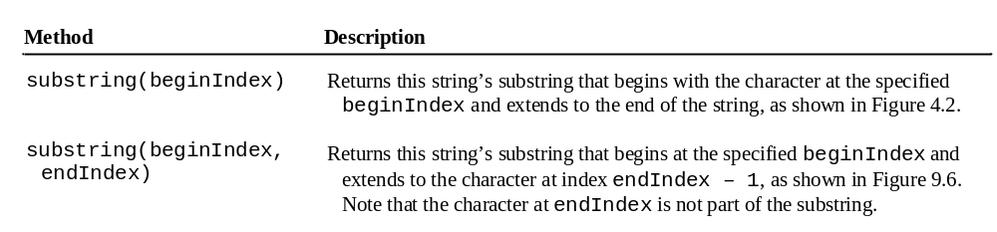
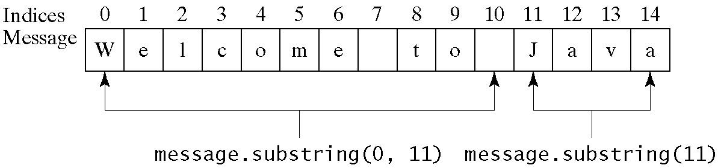
Obtaining Substrings

Slide 14
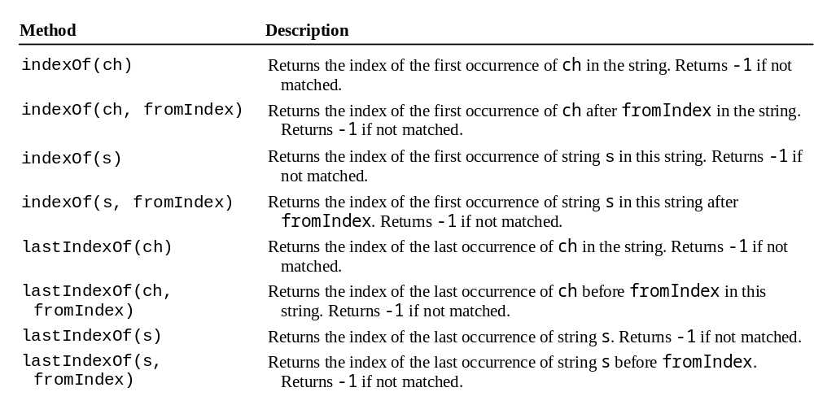
Finding a Character or a Substring in a String

Slide 15
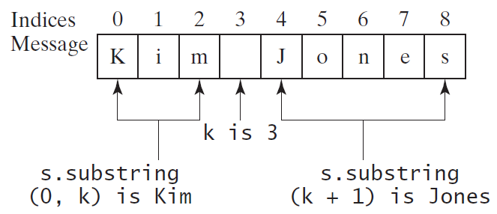
Finding a Character or a Substring in a String
int k = s.indexOf(' ');
String firstName = s.substring(0, k);
String lastName = s.substring(k + 1);

